Slide 1

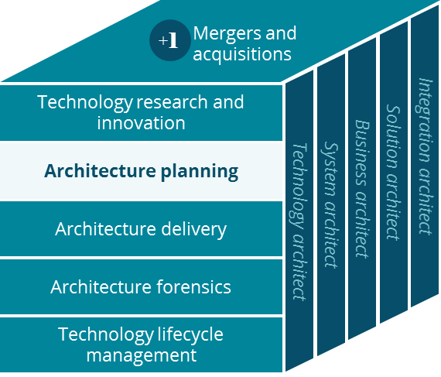
API Management Platform
Architecture Planning
January, 2019

Slide 2


Executive Summary
An API Platform Strategy across Enterprise IT is critical for meeting the company vision and delivering Connected Health at sustainable cost
Opportunity
Conclusions
Recommendations
Taking an “API First” approach will accelerate the integration and sharing of capabilities across the CVS Health and Aetna ecosystems
APIs allow the business to integrate in new ways with suppliers, partners and customers
The company already has thousands of APIs in production with many more to come
A robust cloud strategy is dependent on APIs
While CVS Health has pursued multiple different platforms in different parts of the organization, Aetna has a unified approach based on a single hybrid cloud API management platform
Lowering cost and reducing complexity is achieved through an enterprise API management platform for all systems owned by the Enterprise IT organization, created by adding additional API gateways to the existing hybrid cloud API platform
Build out the single hybrid cloud API management platform for Enterprise IT as outlined during integration planning
Use the hybrid cloud API management platform for all enterprise IT APIs and use APIs for all cross domain real time interactions
Adopt an enterprise methodology for developing APIs to rapidly scale and drive down development cost per API

Slide 3

Business Opportunity
The API Economy is a major opportunity for driving innovation and turning existing systems and platforms into first class citizens of a digitized business
Opportunity Statement
Overview
Taking an “API First” approach will accelerate the integration and sharing of capabilities across the CVS Health and Aetna ecosystems
Engagement:
APIs enable new integrations with suppliers, partners and customers
Business Operations:
Properly managed APIs increase operational stability and decrease integration cost
Turning Legacy to Advantage:
APIs enable us to differentiate through our broad set of existing capabilities

Slide 4



Why is it Important to the future of the Company?
The API Platform is a key component in our business strategy, it enables innovation and fuels transformation
The API platform is the foundation for a Connected Health ecosystem that combines low cost solutions and business excellence. APIs are managed points of access across partner, business and IT systems.
Open
Ecosystem
Controlled Sharing
Security and Audit
Easy
Access
Accelerated
Innovation
APIs enable an open ecosystem, creating easy and ubiquitous connections between different systems.
APIs control exposure and sharing of data. As the owner you decide who you want to share with and how much.
APIs have built-in security and audits. They are much harder to “hack” than general purpose software.
The API consumer doesn’t need to understand underlying systems, data bundling across sources.
APIs disintermediate the API consumer from the backend systems, thus allowing each to change independently.
APIs allow the business to integrate in new ways with suppliers, partners and customers.
APIs are easy to use. As a consumer you see the catalog of API’s that you have been pre-approved for.
Security and audit is enforced by the platform, making life easier for developers.
APIs establish a unified data language across solutions, bridge the gap between business needs and source data.
APIs make experimentation easy, quick and cheap.

Slide 5
What does Success look like?
Six categories of capabilities make up the foundation of a fully mature API management platform implementation (which is much more than middleware)
Domain API Owners
Always use APIs when crossing domains
Robust Accelerators
API development using standard components, policies, and authorization
API consumption leverages global catalog, uniform tokens
Standard Security
Next Gen Authentication
Standardized security policies and policy enforcement
API owners are the domain owners
Policy Ownership including Traffic Throttling
Hybrid Cloud
Deploy APIs in all compute environments, closest to the data source
Leverage a single management console
Network Optimization
Cloud Network Brokers
Accelerate Internal API Invocations
Global Authentication
Leverage Global ID and Account for Life
Ability to pass user level information to backend services

Slide 6
What does Success look like?
For the teams that leverage the API Management Platform – What’s in It For Me
Infrastructure Organization
API Provider Teams
Application Development Teams
Global Security
Simplified Network Optimization
Minimized Latency
Common Service Level Reporting and Monitoring
Coordinated Business and Technical Monitoring
Standardized Dev processes
Minimized resource contention
Consistent Auditing
Consolidated Reporting
Policy Protected Back End Systems
Rapid development and low cost
Seamless User Experience
Consistent Security Enforcement
Centrally Controlled API Keys
Less Administrative Overhead
Simplified Feature Roll Out
Single User Token Recognized across the CVS Health Ecosystem
Single Developer Portal
Single API Catalog
Enhanced User Forum
Simplified On Boarding
Simplified Access Token Code
Shared Authorization Framework

Slide 7
Recommendations
Standardize API management for all of Enterprise IT in accordance with the conclusions from the Integration Planning workstream
Recommendations
Extend the current Hybrid Cloud API management platform with API Gateways in additional data centers and other compute environments, in accordance with joint CVS Health/Aetna integration program plans (lowest platform implementation cost and shortest timeline)
Standardize approach to API domain ownership across all of Enterprise API, as well as the roles and responsibilities for end to end API development and management processes
Close remaining capability gaps in the network optimization and accelerator categories, aiming at maintaining a globally predictable $5K cost for new APIs and at streamlining IT operational processes
Additional Recommendations
Create a roadmap for any existing integrations for cross domain interaction that may need enhancements

Slide 8
API Management - Enterprise IT Direction
A single API management platform that simplifies creation, management and consumption of APIs, keeps API development costs low and security high
Highlights
API Consumers
API consumers can access any API on any gateway with the same security token; single set of policies and crypto materials
DataPower gateways in multiple datacenters
Cross Domain traffic uses managed APIs for access (even inside a datacenter)
APIs are packaged in multiple way for different API consumers
Single portal where API consumers subscribe to APIs (access levels configurable)
Single Management Console provides consolidated devOps and analytics
Gateways are co-located with backend data and services; production, stress, QA and dev supported
Unique Capability
1
4
5
Developer Portal
1
2
Management Console
6
3
Analytics
4
2
DP GW - DC
DP GW - AWS
DP GW - Azure
5
Data Provider(s)
Data Provider(s)
Data Provider(s)
Ultra low cost, nimble speed
API E2E: ~$5K (industry leading)
New APIs in days to weeks
API changes in hours to days
6
7
7
3

Slide 9
Recommended Policies and Guidelines
Enterprise API Management Platform
The API layer will only do light weight mapping and redaction, no orchestration and no complex transformation
All APIs will be subject to the same standards and governance policies
Industry standards will be followed for authentication and authorization (i.e. OAuth and Open ID Connect, preference for user tokens over app tokens)
Cross domain (functional, geography or security) real time access to data and functionality must go through a managed API, even for company internal routes
APIs will always be hosted on API gateways co-located with underlying functions and data
APIs must be owned and managed by associated domain owner who will be accountable for product characteristics (access, throttling, performance, availability, etc.)
End user identity must be propagated to the backend supporting an API and all backend services must enforce requisite authorization and data confidentiality policies for access to the HIPAA, PHI, PII and PCI data
APIs are required to enforce policies for appropriateness of access, and least privilege needed to do work
APIs are independently management objects with their own devOps lifecycle
API creation is done using the accelerators intrinsic to the enterprise API management platform
In order to simplify change management, APIs will be built for single consumers (Opportunistic) or global enterprise consumption, nothing in between
All APIs must return data in business friendly and platform neutral form (i.e. minimize the need to translate/transform data on the API consumer side)
Opportunistic APIs must return data in the form desired by their particular single consumer
Composite (multi-domain) APIs may be owned by one of the underlying domain owners or by a consuming side team
The company will have thousands of APIs; we must carefully manage catalog ownership as well as appropriately restrict visibility on the API consumer side
Pol
Policies / Guardrails
Pol
Additional Guidelines

Slide 10
Necessary Actions
Institutionalize adoption of the Enterprise IT API Management Platform
Area
Necessary Actions
Infrastructure
&
Middleware
Implement DataPower API Gateways in CVS Health datacenters (and cloud environments)
Integrate with combined company Global ID, Account for Life, Individual Preferences and Features API per existing plan for the CVS Health and Aetna integration program
Determine API management platform middleware ownership and support model for the combined company (infrastructure ownership resides with the integrated infrastructure team) - COMPLETED
API Development
&
API Consumption
Define and implement API domain owner structure for the combined company
Establish a rollout and education plan for the “API first” strategy for Enterprise IT
Evaluate and optimize ESB middleware and approach to service development and management (a richer and more robust set of services, at low cost, will accelerate API creation as well as company integration and transformation)
= Guidance on previous investment decisions
= Recommendation for new work / investment

Slide 12
Spotlights

Slide 13


Rationale for recommending API Connect
The cheapest and fastest route to a single Enterprise API Management platform; selecting between IBM’s API Connect and Googles Apigee platforms
EXPERIENCE
FOUNDATIONAL
A coordinated experience
that wows you
Insight to help you
achieve your goals
Integration that gives you access to everything
Apigee lacks proven ability for hybrid cloud deployment with gateways in all compute centers and a single shared access token
While the Apigee experience for API product management is a bit more advanced, the delta is not significant for Enterprise IT use
Proven ability to influence API Connect vendor roadmap to meet company needs
DataPower heritage as a security gateway enables additional protection and security insight
Broad based IT operational experience with DataPower
Implementing a new API management platform is a major investment, not only in middleware and hardware, but more importantly in accelerators and best practices
Migrating 1000+ existing Aetna APIs is cost prohibitive
Security and Stability

Slide 14
Aetna Current State - Operational Data Availability
~70% of all operational data is already accessible via the integration platform, planned migration will take that to ~85%
Quoting and Rating
Plan Sponsor
Financial
Health Benefits
Provider
Analytics
100%
100%
100%
95%
75%
75%
CPQ Automation
FDR (Local Enable)
Medicare Migration
Provider Data Inno.
Clinical Feeds
Partners (Others)
Broker
Member
Product and Offering
Sales and Marketing
Clinical
70%
65%
60%
45%
45%
40%
Prospects & bswift
Clinical Platform
Contact Center
Specialty
Pharmacy
Health Fund
35%
25%
20%
0%
Service Platform
CVSH Partnership
Payflex Roadmap
Active Program/Activities

Slide 15
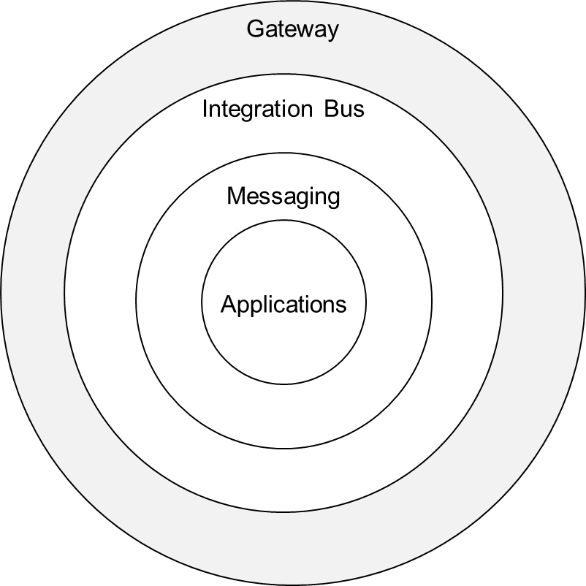
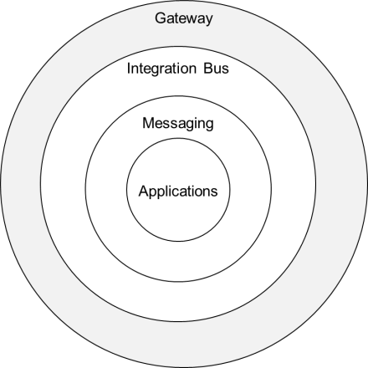
If you have the Service, then it’s easy to create one or more APIs
Enterprise APIs
Enterprise Services
Messaging
IT Systems
Situational apps
Enterprise systems
Opportunistic Services
Opportunistic APIs
... some APIs are purposefully short lived…

